Slide 1
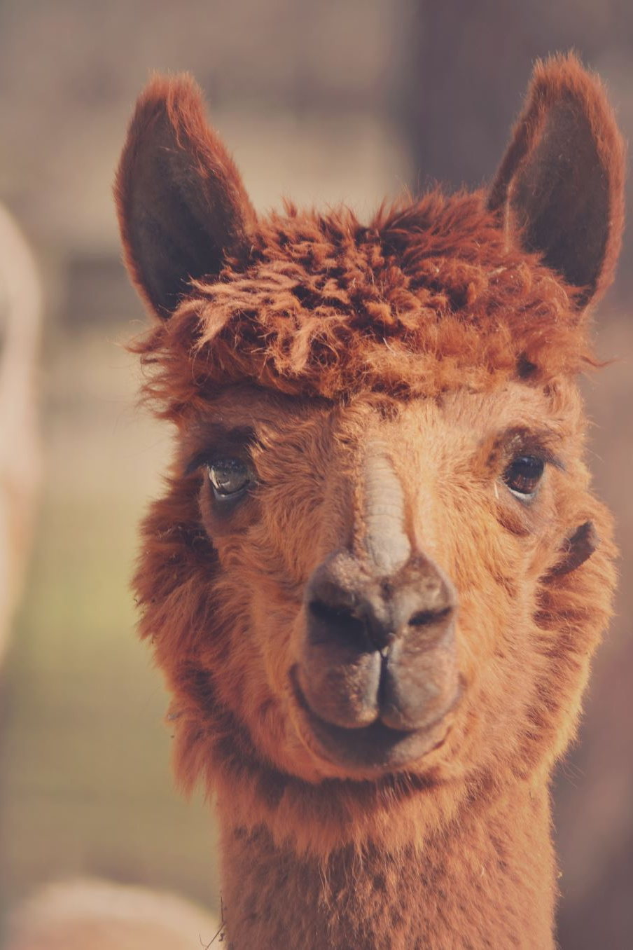
Grammar & Basics
If-Conditionals

Slide 2
Talking about conditions
There are three main types, which are used to express different things.
In pairs, discuss your intuitive understanding of how they differ.
If we buy a dishwasher, we will save time
If I won a million dollars, I would quit my job
If she had taken a taxi, she would have arrived there in time

Slide 3
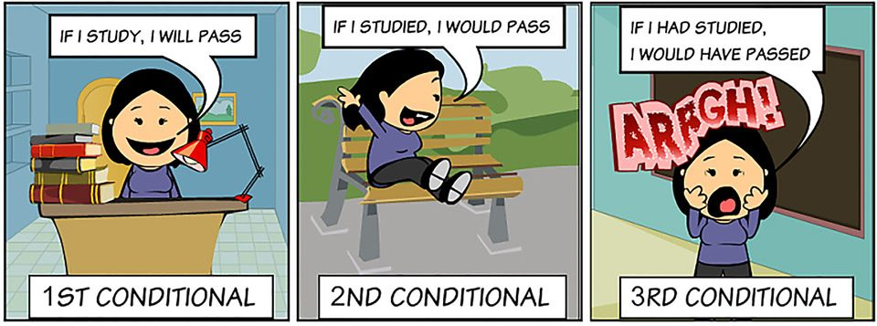
If-Conditionals
In English you often talk about the outcome of certain conditions in sentences with ‘if…’

Slide 4
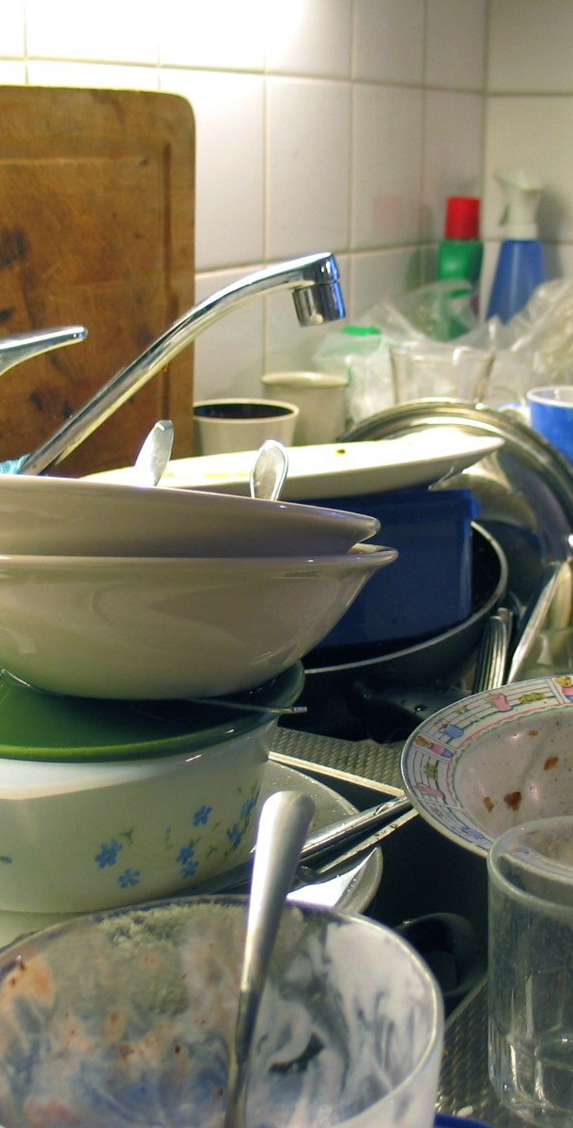
Type 1
“If we buy a dishwasher, we will save time”
Present form (buy) in the if-part
This means that it is likely that we will buy a dishwasher
The result in the other part is also likely to happen
That’s indicated by will + verb (will save) in the other part

Slide 5

Type 2
“If I won a million dollars, I would quit my job”
Past form (won) in the if part
This means that it is unlikely that I would win a million dollars
The result in the other part is also unlikely to happen
That’s indicated by would + verb (would quit) in the other part

Slide 6
Type 2
Also used for things that are impossible to happen
If I ruled the world, we would have 4 day-weekends
If you use it in this way you always use were as the past form of (to) be (not was)
If I were a wizard, I would go to Hogwarts.

Slide 7

Type 1 and 2 compared
If he works hard he will pass his exam
In the first example you are talking about an active student who is likely to work hard (and therefore pass the exam)
If he worked hard he would pass his exam
In the second example you are talking about a student who is unlikely to work hard for whatever reason (and therefore unlikely to pass his exam)

Slide 8
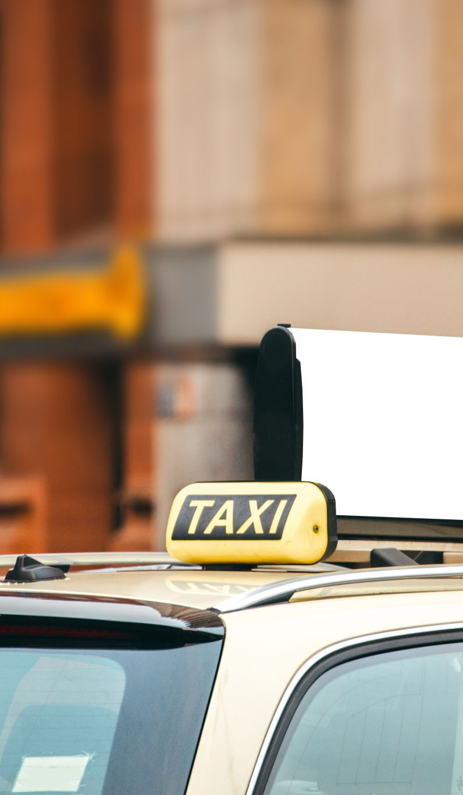
Type 3
“If she had taken a taxi, she would have been there in time.”
The past form with had (had taken) in the if part
This indicates you are talking about the past, so she can’t take a taxi anymore
You can speculate about what if she had
This is indicated by would have + verb + ed (for irregular verbs, 3rd column)

Slide 9
Type 1, 2 and 3 compared
If you give me money, you will get a higher mark.
If you gave me money, you would get a higher mark.
If you had given me money, you would have got a higher mark.

Slide 10
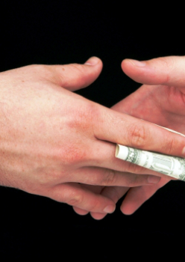
Type 1
If you give me money, you will get a higher mark.
This indicates that you’re likely to give me money and as a result get a higher mark.

Slide 11
Type 2
If you gave me money, you would get a higher mark.
This indicates that you’re unlikely to give me money (and as a result I’m unlikely to give you a higher mark)

Slide 12
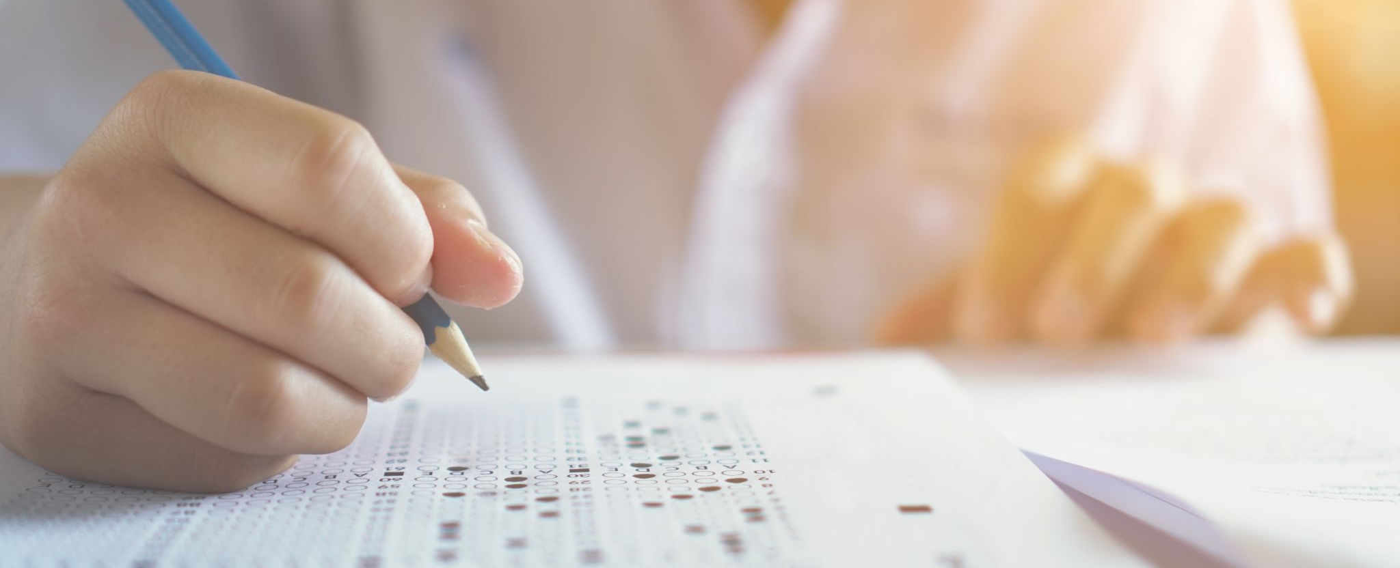
Type 3
If you had given me money, you would have received a higher mark.
This indicates that the exam results are already processed, so the moment to give me money is already over.

Slide 13
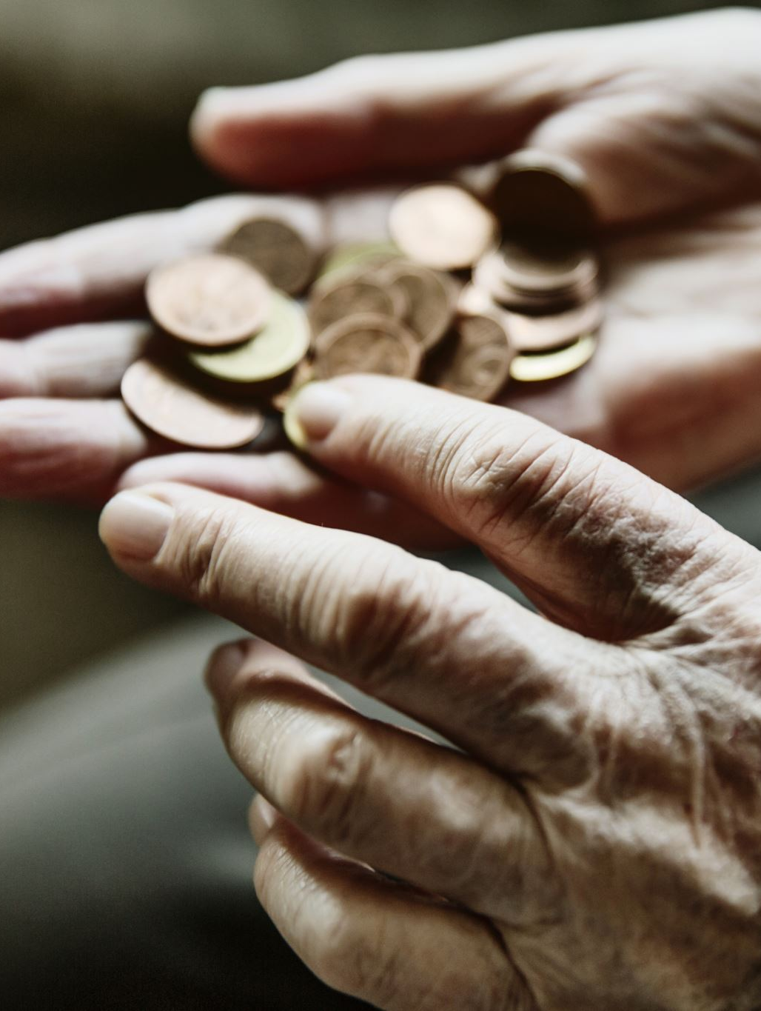
Giving teachers money
Unfortunately for you none of this is true, because
If I were in it for the money, I wouldn’t be a teacher.

Slide 14
Do not use ‘will’ or ‘would’ in the if-part
If it will rain, I will bring an umbrella If it rains, I will bring an umbrella
If he would clean up, he wouldn’t lose his stuff. If he cleaned up, he wouldn’t lose his stuff.
If he would have called, I would have come to the right place If he had called, I would have come to the right place

Slide 15
The order of the parts can be changed
If it rains, I will bring an umbrella → I will bring an umbrella if it rains.
He wouldn’t lose his stuff if he cleaned up. → If he cleaned up, he wouldn’t lose his stuff.
I would have come to the right place if he had called me → If he had called, I would have come to the right place

Slide 16
Exercise: Correct the incorrect conditional
If knew she was ill, I would have sent her some flowers.
If my flat has a balcony, I would grow plans in pots on them.
Where will you like to live if you could choose?
I can’t see Mary. If she is taller, I could see her.
If I played better, the team would have won the match.
If I catch the train at one, I would arrive in time
I would buy organic food if it is cheaper. At the moment it is too expensive.
She wouldn’t have gone to University if she didn’t work hard at school.
If you had lived tow hundred years ago, what would you do?

Slide 17
Exercise: answers
If I had known she was ill, I would have sent her some flowers.
If my flat had a balcony, I would grow plans in pots on them.
Where would you like to live if you could choose?
I can’t see Mary. If she were taller, I could see her.
If I had played better, the team would have won the match.
If I catch the train at one, I will arrive in time
I would buy organic food if it was cheaper. At the moment it is too expensive.
She wouldn’t have gone to University if she hadn’t worked hard at school.
If you had lived tow hundred years ago, what would you have done?

Slide 18
Exercise: Finish the conditional
If it is sunny tomorrow _______________________________________________
If you sit in the sun too long __________________________________________
If I were you _______________________________________________________
If I were the Prime Minister ___________________________________________
If she had studied harder _____________________________________________
If I won the lottery __________________________________________________
If I hadn’t gone to bed so late _________________________________________
If I hadn’t come to London ___________________________________________
If you mix water and electricity ________________________________________
If she hadn’t stayed at home __________________________________________

Slide 19
Finish the conditional (example)
If it is sunny tomorrow, we'll go to the park.
If you sit in the sun too long , you get burned.
If I were you, I would go out tonight.
If I were the Prime Minister, I would make the museums free.
If she had studied harder, she would have passed the exam.
If I won the lottery, I would buy a big house.
If I hadn’t gone to bed so late, I wouldn't have been tired.
If I hadn’t come to London, I would have gone to New York.
If you mix water and electricity, you get a shock.
If she hadn’t stayed at home, she would have gone shopping

